Slide 1

Lesson 6 - Occupancy Grids (2)– Lecture Populating the occupancy grid
Intelligent Mobile Robotics
Dr. Aboozar Taherkhani (PhD)
email: aboozar.taherkhani@dmu.ac.uk

Slide 2
Overview
Recap
Application of Bayes’ theorem
Implementation details
Coursework

Slide 3
The Occupancy Grid
Initial occupancy grid everything is 0.5

Slide 4
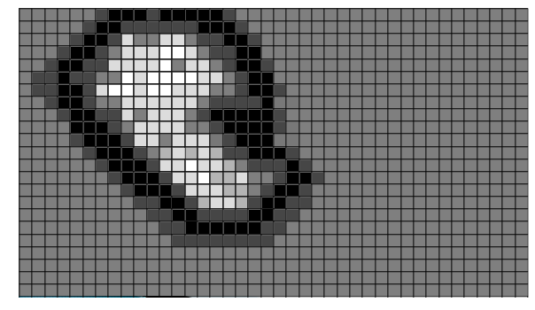
The Occupancy Grid
After some time

Slide 5
Recap
Last week we projected a sonar model on to a grid
The probability of each grid square in the sonar ‘cone’ was set

Slide 6
Sonar Model
Simple model from last week
How to apply different reading on to the grid?
Bayes’ Theorem
3
1
2

Slide 7
Recall Bayes’ Theorem
Bayesian Occupancy grid Filter for dynamic environments using prior map knowledge
An Intuitive (and Short) Explanation of Bayes’ Theorem
bayes theorem sonar map search on youtube

Slide 8

Recall Bayes’ Theorem
Conditional probability:
H is a hypothesis (something we wish to test the truth of), E is the available evidence, then:
p(E | H) is the likelihood of the data, given the hypothesis.
p(H) is the prior probability of the hypothesis.
p(E) is the prior probability of the evidence (used to normalise the probabilities)
p(H | E) is the posterior probability of the hypothesis – the probability that H is true given the evidence E.

Slide 9
Recall Bayes’ Theorem
How does this relate to mapping?
The hypothesis, H, is that a given grid square is occupied
p(H) is the probability that a grid square is occupied (prior probability)
P(H) = P(Occupied)
P(H) = 1-P(Empty)
P(Occupied) + P(Empty) = 1
p(H) + p(¬H) = 1
Example for p(H): A robot is programmed to move in an area of Mars where 75% of the area is covered with rocks (obstacles)

Slide 10
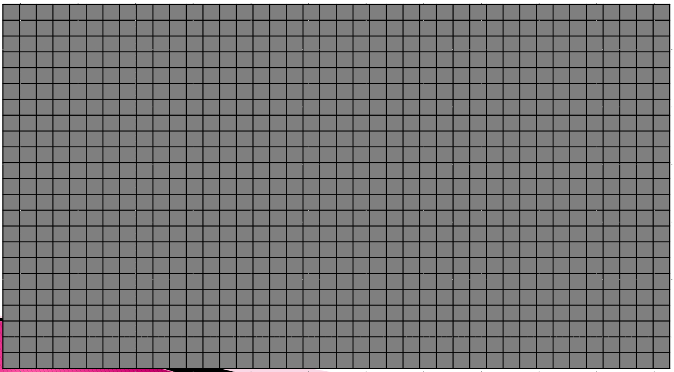
Example for p(H)
The robot knows in advance that the next region it scans has P(H= Occupied) = 0.75
The Unconditional probability or Prior probability, P(H), does not take into account any sensor reading
Usually the prior probability, p(H), is known in advance, and it can be used to obtain p(H|E) using bayes’ rule
If the knowledge is not available it is assumed that
P(Occupied) = P(Empty) =0.5
p(H) = p(¬H) = 0.5

Slide 11
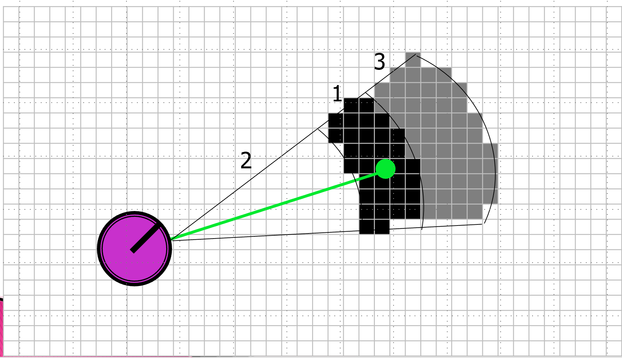
How does this relate to mapping? (2)
p(E | H) is given by the sonar model
p(E | H) is the probability a sensor would return given the grid square was really occupied

Slide 12
How does this relate to mapping? (2)
p(E) is the second prior probability used for normalising the conditional probability
p(E) = p(E|H)p(H)+p(E|¬H)p(¬H)
p(H | E) is the posterior probability of the hypothesis – the probability that H (there is an obstacle) is true given the evidence E (new sonar reading)
p(H | E) is the probability of interest for occupancy grid that can be obtained using Bayes’ rule
See Murphy 11.3.2 page 384 (‘E’ is replaced by‘s’)

Slide 13
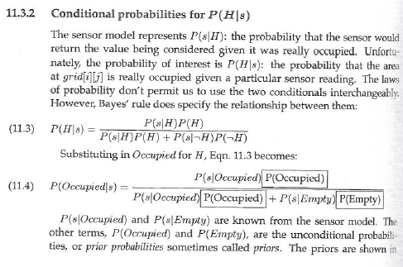
Conditional probabilities have the property that:
p(s|H) + p(s|¬H) = 1

Slide 14
Bayes’ Theorem
So we can now update the occupancy grid when we get a single reading
If we only use this method we overwrite our hard gained evidence
We need to use this previous evidence and update rather than overwrite
Two probabilities, either from two different sensors sensing at the same time or from two different times, can be fused using Bayes’ rule

Slide 15

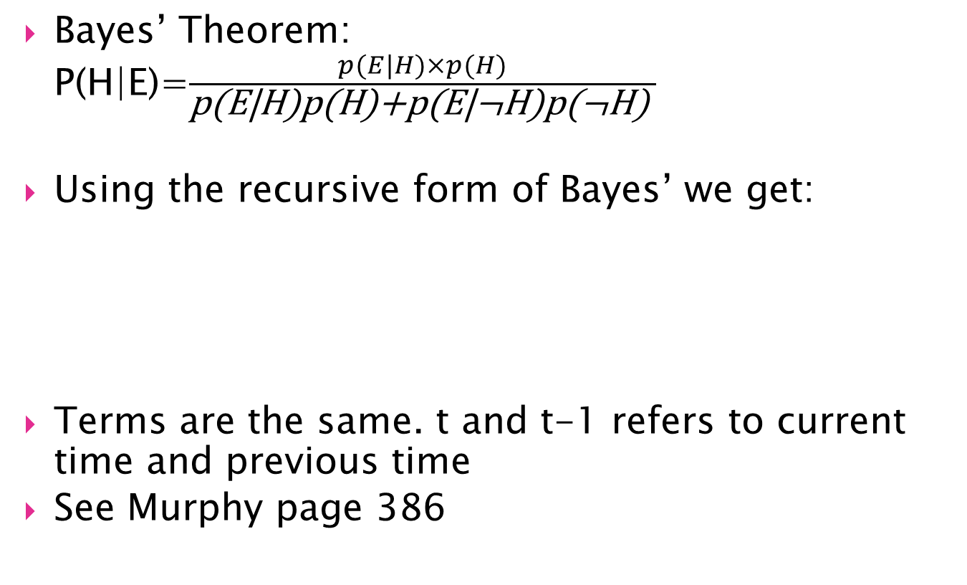
Recursive Bayes’ Theorem
Bayes’ Theorem: P(H|E)=$\frac{p(E|H)×p(H)}{\text{p}\text{(}\text{E}\text{|}\text{H}\text{)}\text{p}\text{(}\text{H}\text{)+}\text{p}\text{(}\text{E}\text{|¬}\text{H}\text{)}\text{p}\text{(¬}\text{H}\text{) }}$
Using the recursive form of Bayes’ we get:
Terms are the same. t and t-1 refers to current time and previous time
See Murphy page 386

Slide 16
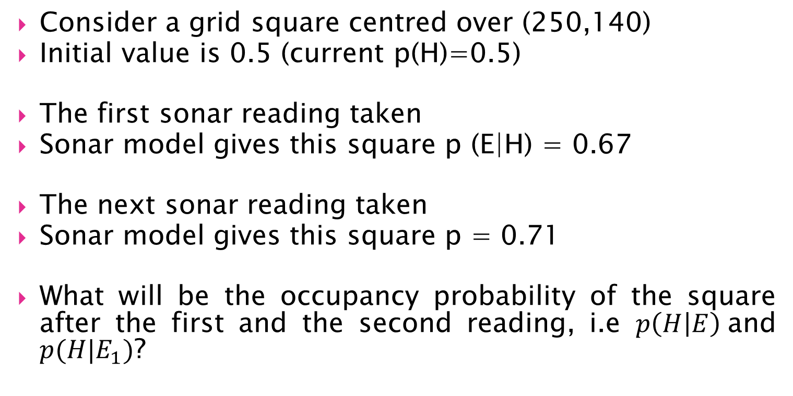
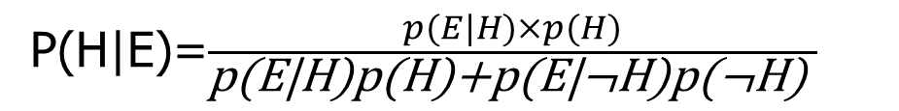
Calss activity
Consider a grid square centred over (250,140)
Initial value is 0.5 (current p(H)=0.5)
The first sonar reading taken
Sonar model gives this square p (E|H) = 0.67
The next sonar reading taken
Sonar model gives this square p = 0.71
What will be the occupancy probability of the square after the first and the second reading, i.e $p\left(H | E\right)$and $p(H|E_{1})$?
P(H|E)=$\frac{p(E|H)×p(H)}{\text{p}\text{(}\text{E}\text{|}\text{H}\text{)}\text{p}\text{(}\text{H}\text{)+}\text{p}\text{(}\text{E}\text{|¬}\text{H}\text{)}\text{p}\text{(¬}\text{H}\text{) }}$

Slide 17

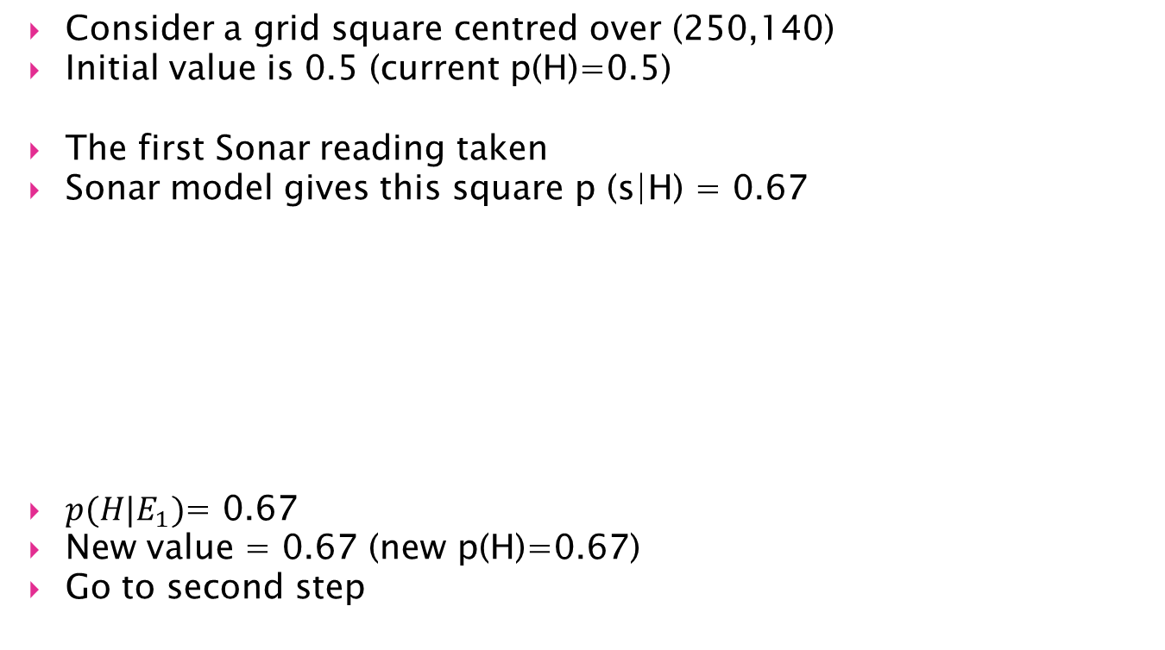
Simple Worked Example
Consider a grid square centred over (250,140)
Initial value is 0.5 (current p(H)=0.5)
The first Sonar reading taken
Sonar model gives this square p (s|H) = 0.67
$p(H|E_{1})$= 0.67
New value = 0.67 (new p(H)=0.67)
Go to second step

Slide 18

Simple Worked Example
Grid square centres over (250,140)
Current p(H) is 0.67
The next Sonar reading taken
Sonar model gives this square p = 0.71
New value = 0.83

Slide 19
Simple Worked Example
This calculation needs to be performed for every square inside the sonar ‘cone’

Slide 20
Implementation Details
Sonar ‘cone’ bounding box
One quick approach:
Bounding Box

Slide 21
Implementation Details
Sonar ‘cone’ bounding box
One quick approach:
(x2,y2)
(x3,y3)
(x4,y4)
(x1,y1)

Slide 22
Implementation Details
Sonar ‘cone’ bounding box
One quick approach:
X1 = robotX + sonar offset
Y1 = roboyY + sonar offset
(x2,y2)
(x3,y3)
(x4,y4)
(x1,y1)

Slide 23

Implementation Details
Sonar ‘cone’ bounding box
One quick approach:
(r$,ϴ_{s})$->(x3,y3)
(x2,y2)
(x3,y3)
β
r
(x4,y4)
(x1,y1)

Slide 24

Implementation Details
Sonar ‘cone’ bounding box
One quick approach:
(r$,ϴ_{s})$->(x3,y3)
r2 = r cos(β)
(r2$,ϴ_{s}+\text{β})$->(x2,y2)
(r2$,ϴ_{s}−\text{β})$->(x4,y4)
(x2,y2)
(x3,y3)
r2
β
r
(x4,y4)
r2
(x1,y1)

Slide 25
Implementation Details
Sonar ‘cone’ bounding box
One quick approach:
xl = min(x1,x2,x3,x4)
yl = min(y1,y2,y3,y4)
xu = max(x1,x2,x3,x4)
yu = max(y1,y2,y3,y4)
Which gives our BB
Can now write a for loop to
iterate over the required
squares in the grid
(x2,y2)
(xu,yu)
(x3,y3)
(x4,y4)
(xl,yl)
(x1,y1)

Slide 26
Implementation Details
Sonar ‘cone’ bounding box
Only iterate over grid squares in the BB
Only update grid square values when they fall inside the sonar ‘cone’

Slide 27
Implementation Details
Decision to be made
We have multiple sensors
Each with it’s own pose
Each has to be moved to a global pose
Many options here
Option 1
Get sonar reading
Apply to single local grid
Repeat for all sensors
Rotate & translate
Apply to global grid

